Slide 1
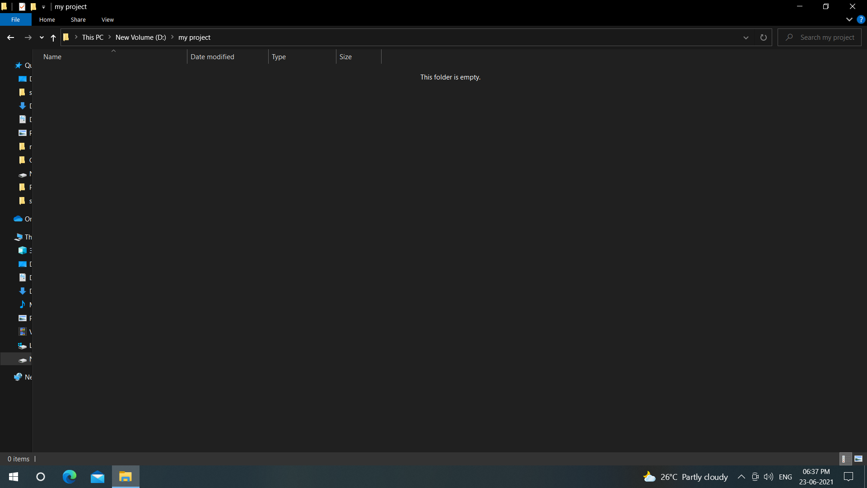
Create a folder in any drive of ur wish

Slide 2
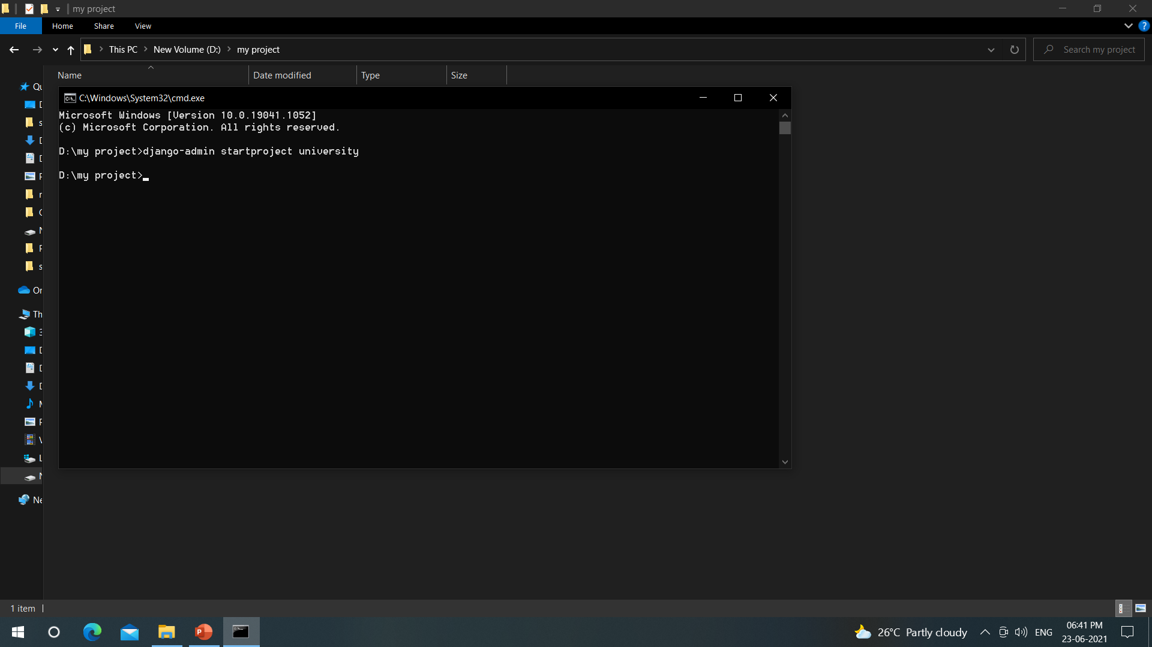
Open command prompt and
1.run the command “Django-admin startproject anyname”

Slide 3
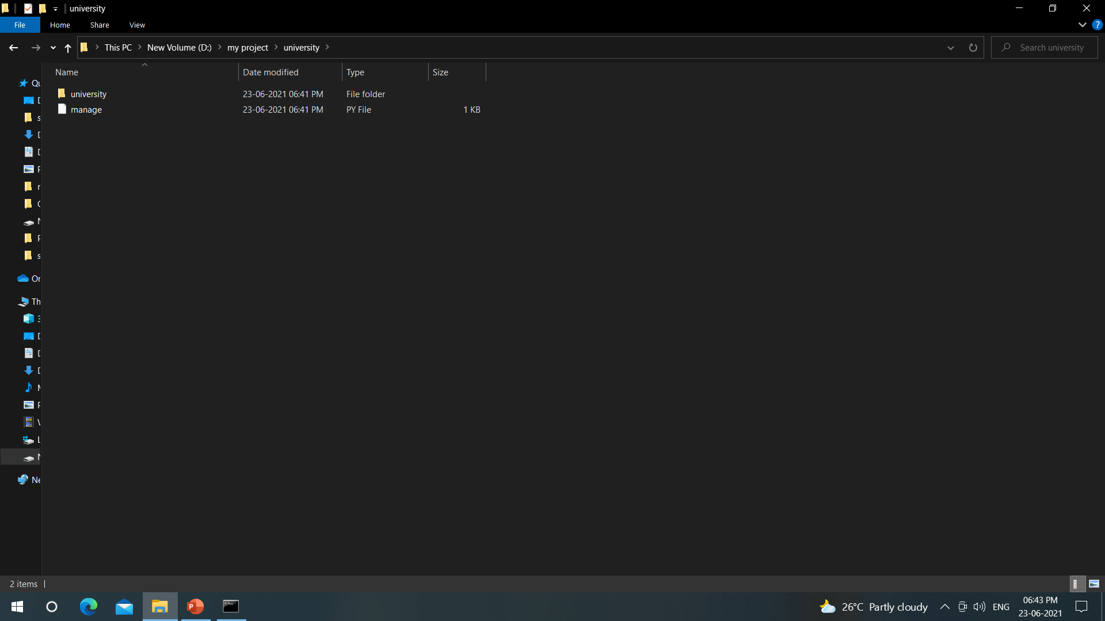
Now check the folder and files you have created

Slide 4
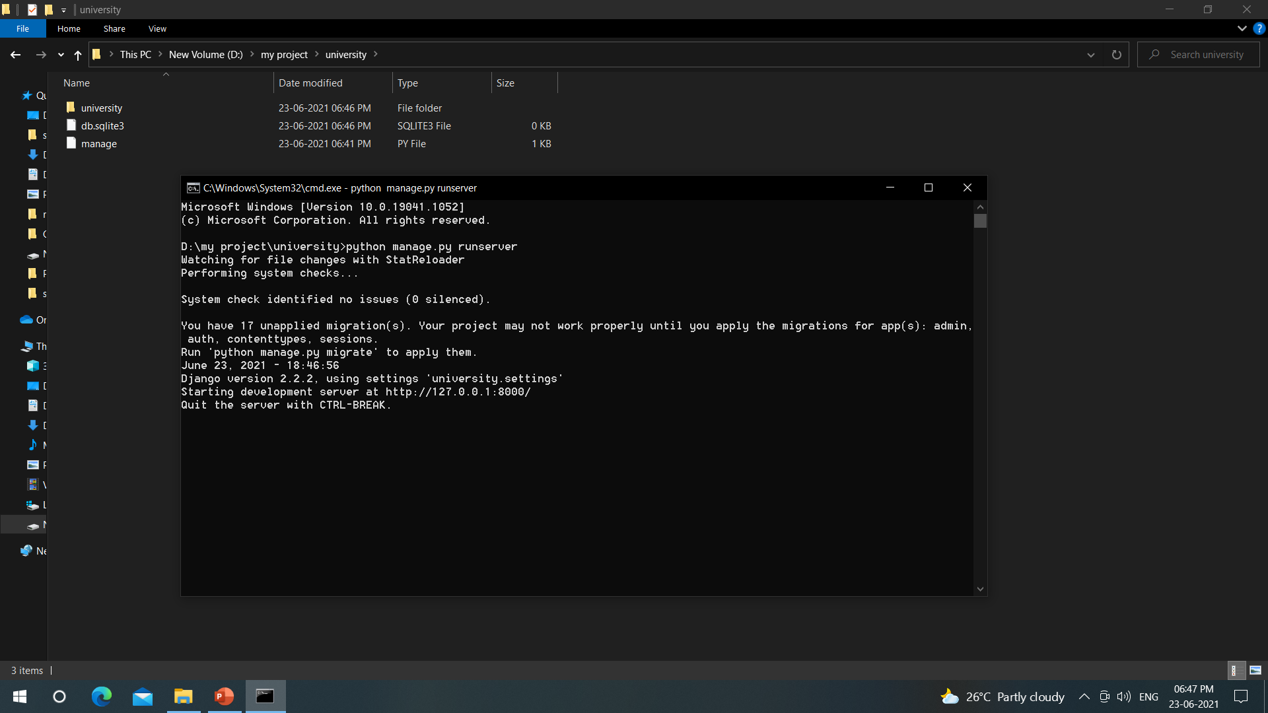
Now open the command prompt
2.Run the command python manage.py runserver
And check it is running without any errors and observe the “db.sqlite3” python file created with 0 KB
Now copy the ip address http://127.0.0.1:8000/
Go to browser and paste

Slide 5
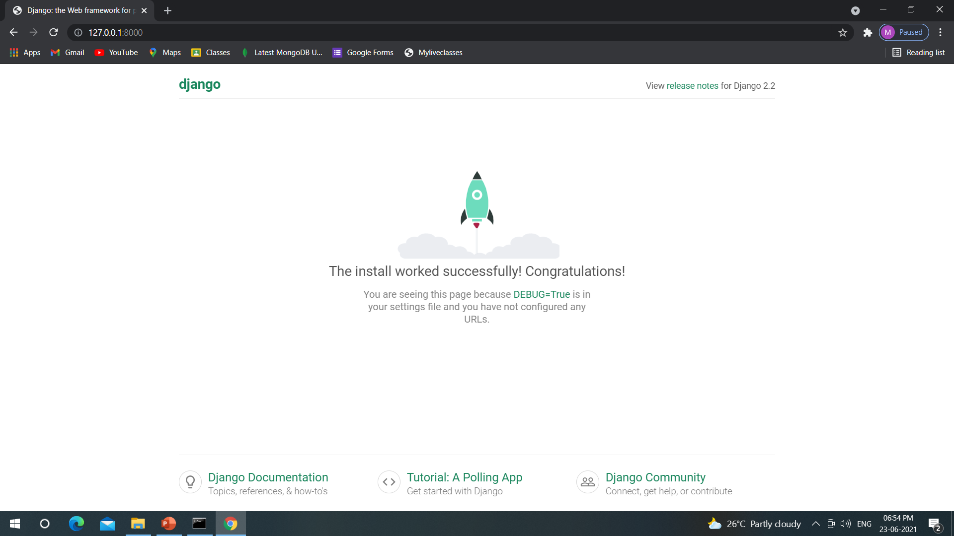
Make sure you get this screen and it is ready to work further

Slide 6
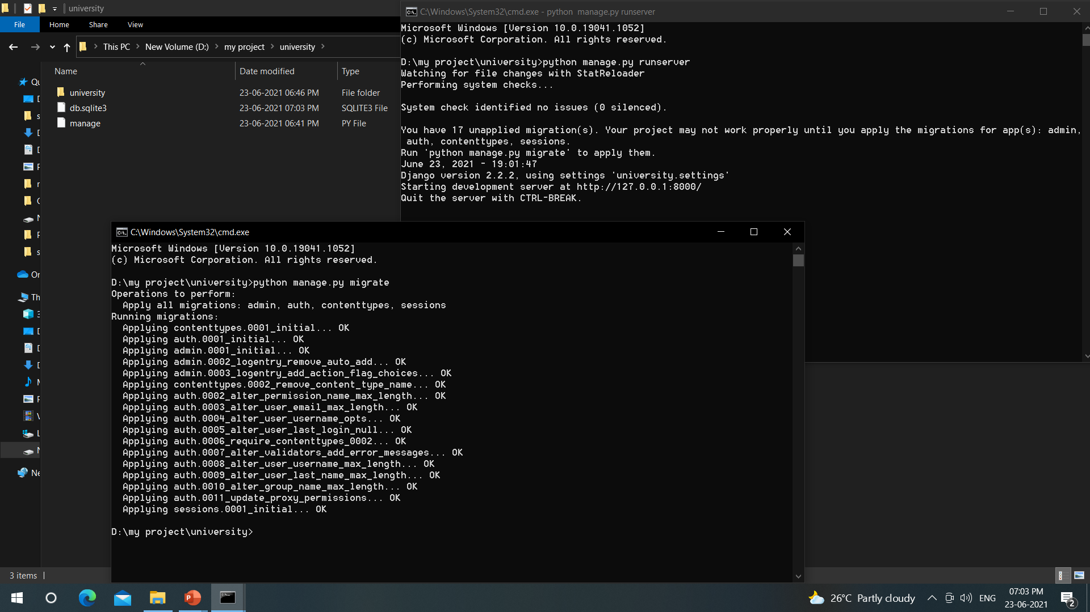
Now open one more command prompt and make sure server is running
3.Run the command “python manage.py migrate”

Slide 7
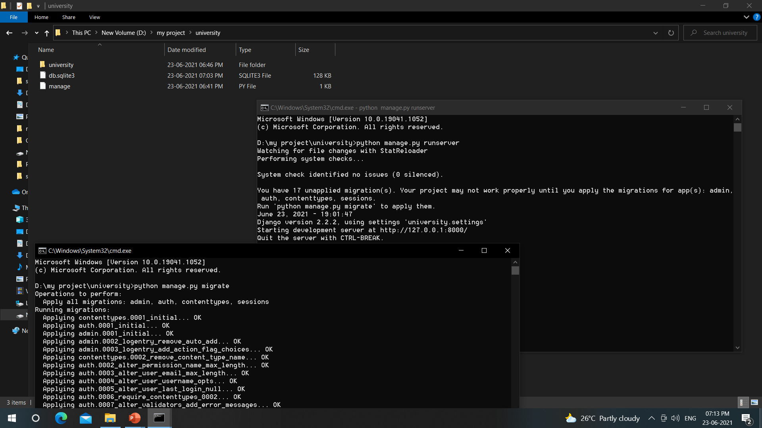
Now observe “db.sqlite3” file updated with 128KB

Slide 8
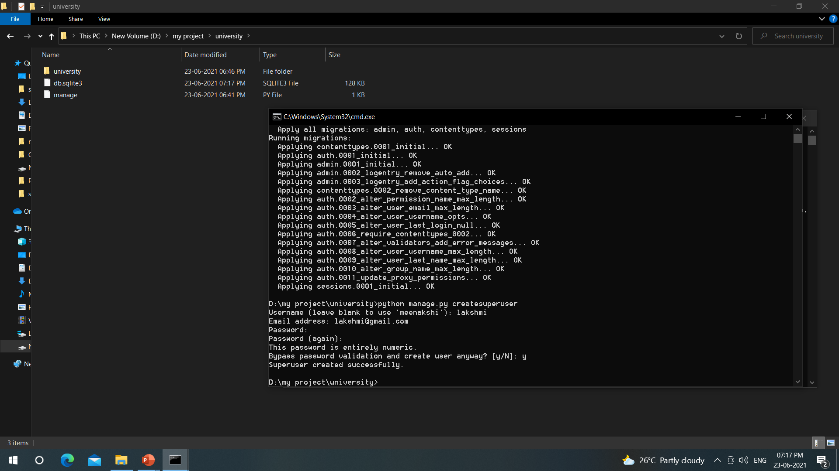
Next
4.run the command “python manage.py createsuperuser”
Also enter name email and password

Slide 10
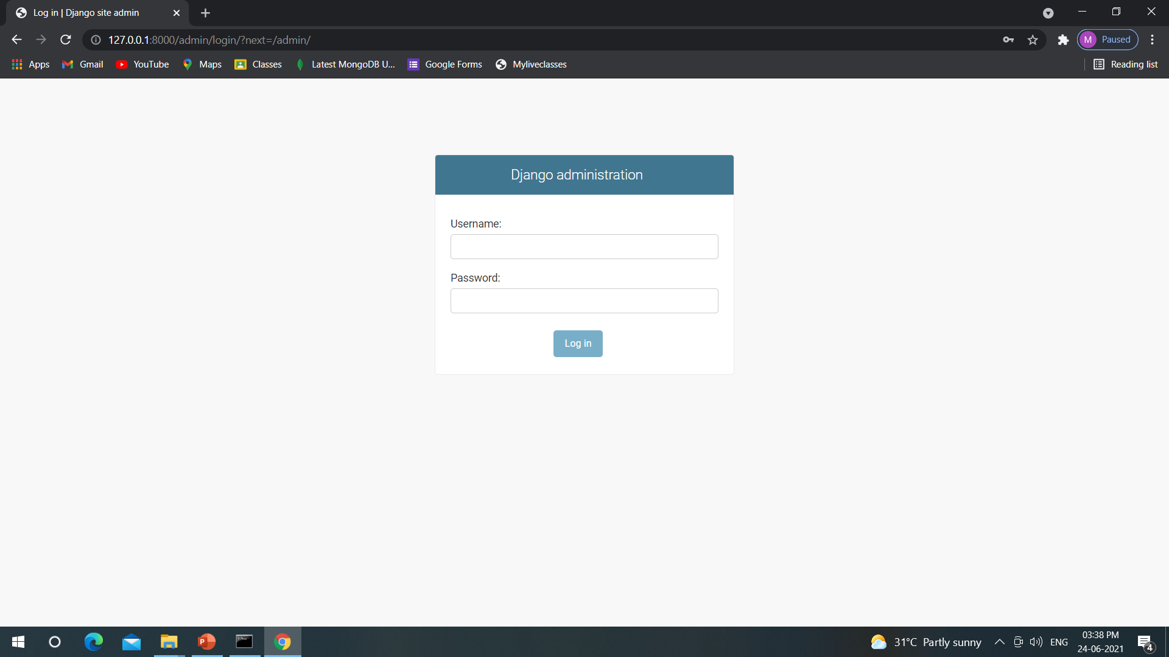
add “/admin/” after the ip address and login with
ur user name and password

Slide 11
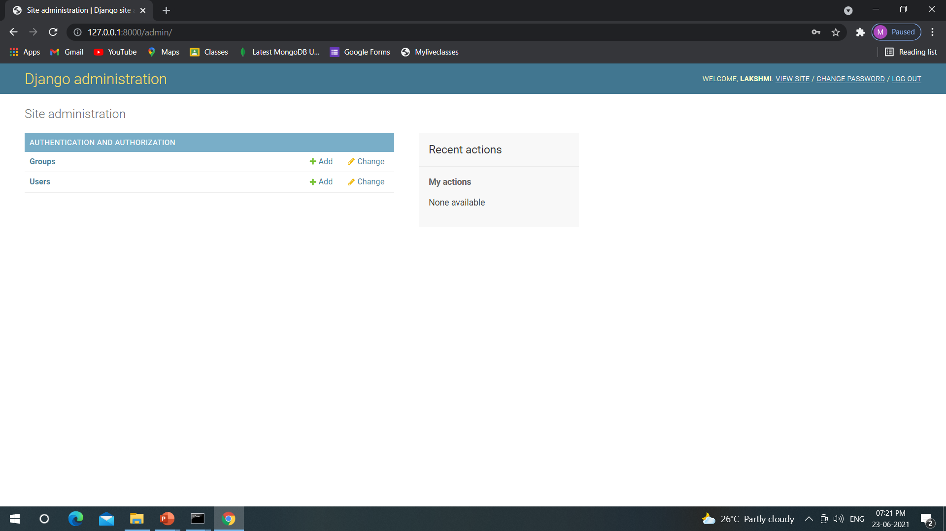
You will get this screen

Slide 12
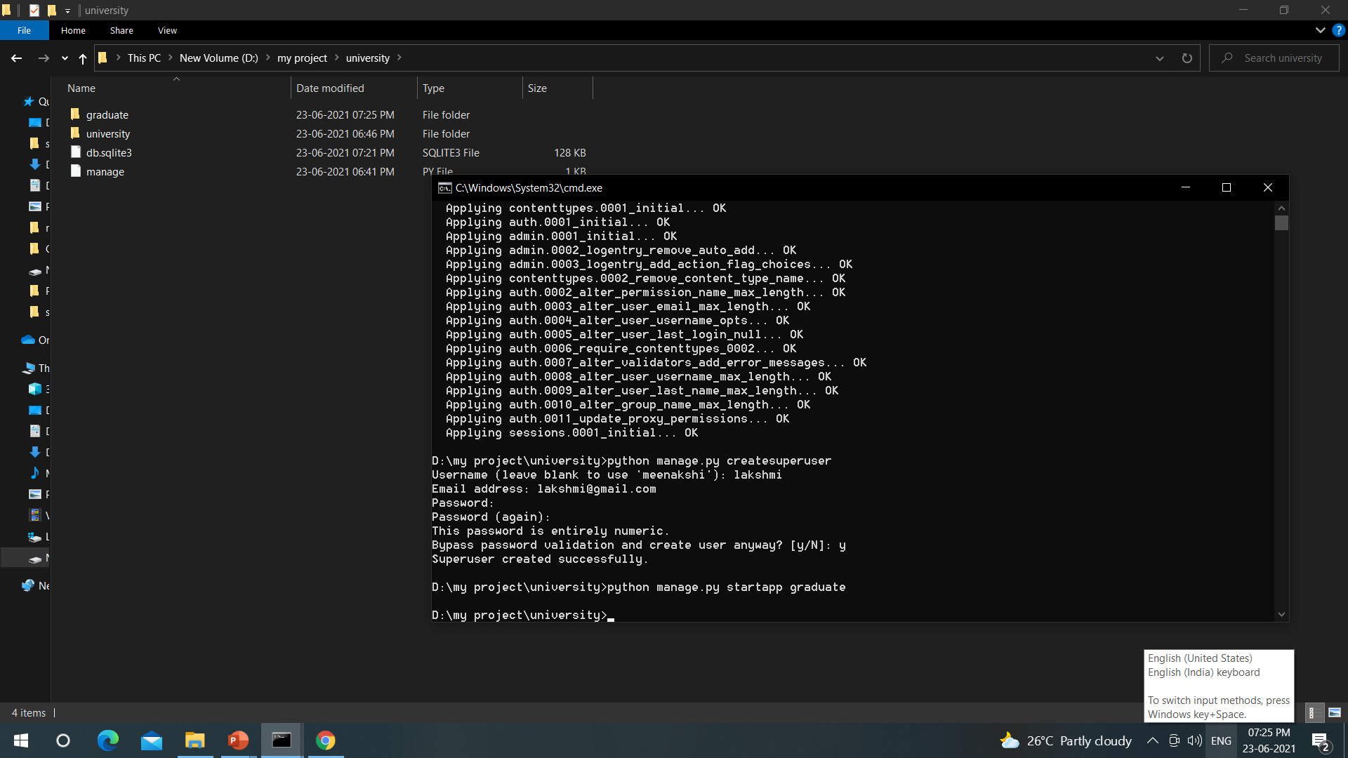
Now its time to create app folder inside
the main Django folder
5.Run the command
“python manage.py startapp anyname”
Make sure the app folder created
inside the main folder

Slide 13
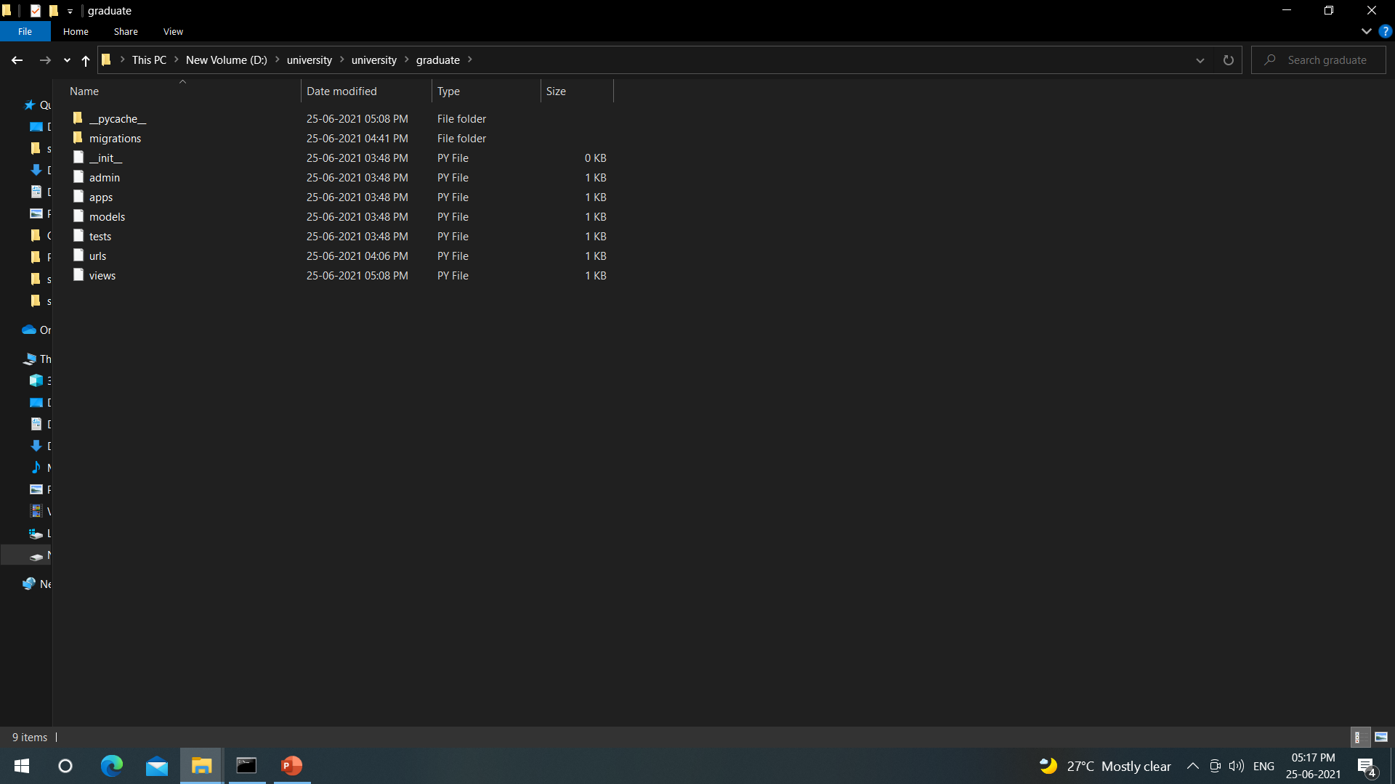
Make sure these files are created in the app folder
Now we have to follow few steps

Slide 14
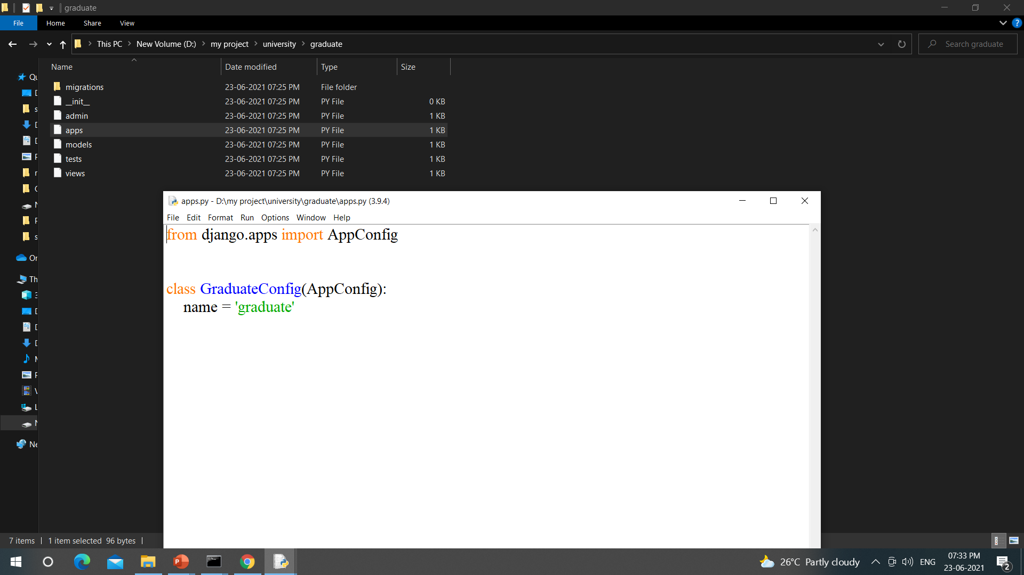
Now open the file “apps.py” and copy the class name

Slide 15
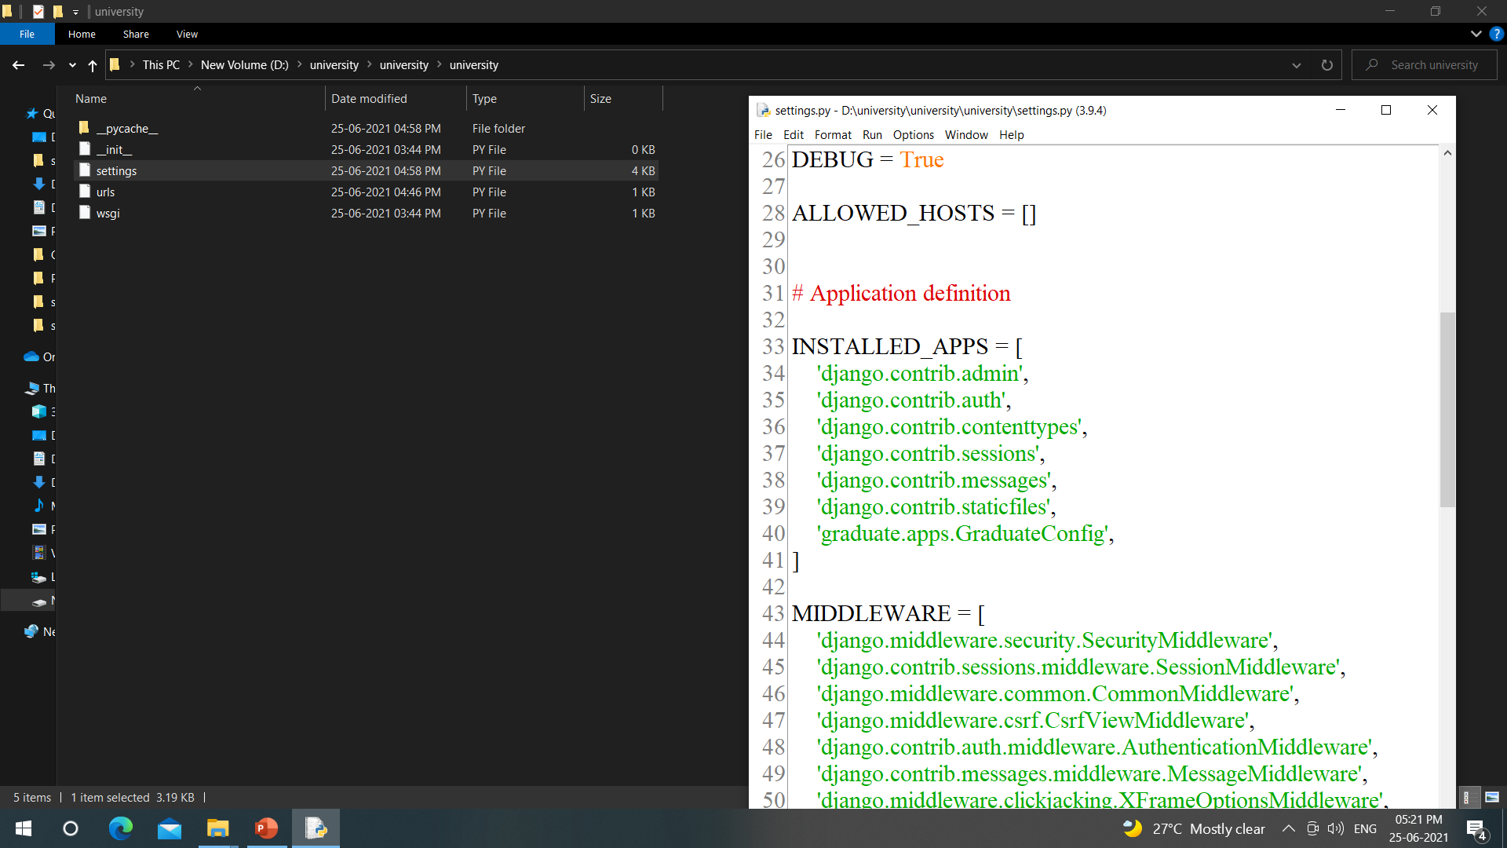
Step 1: adding installed apps under settings.py file
Add line no. 40 “nameoftheapp.apps.copiedclassname”

Slide 16
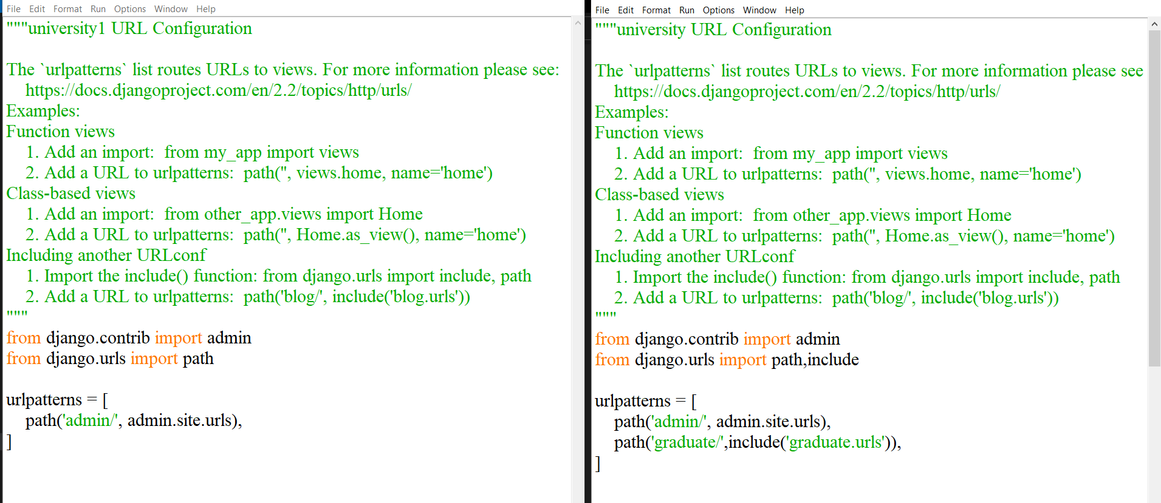
Step 2: urls.py
Open the main folder urls.py and we need to add 1.“include” and
2.path of App, url’s folder
BEFORE
AFTER
1
2

Slide 17
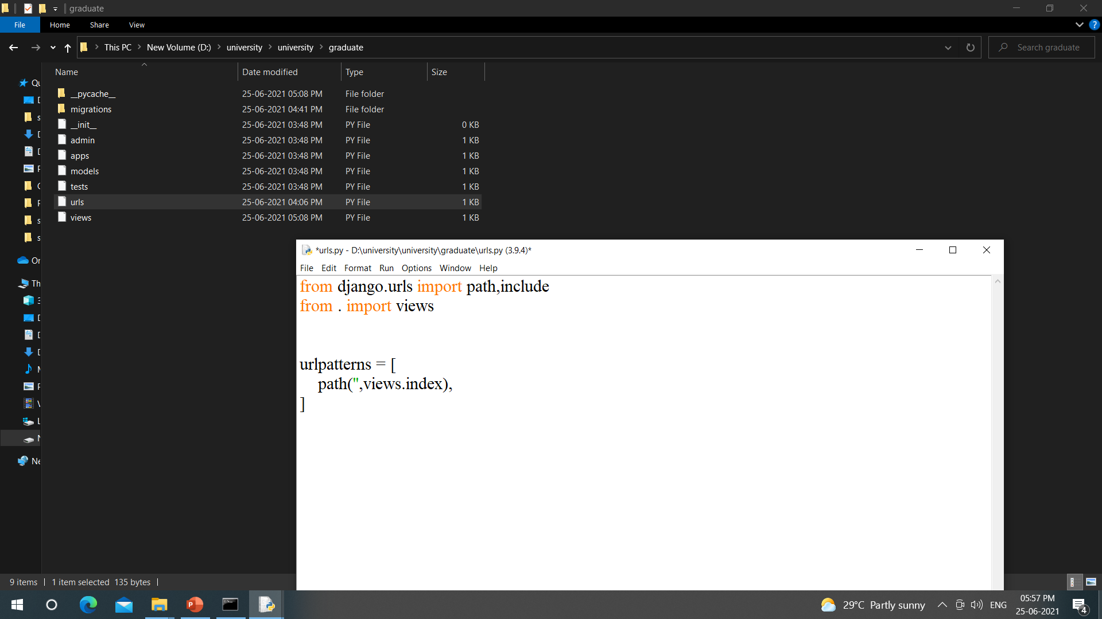
Now create “urls.py” file under app folder and type the below code

Slide 18
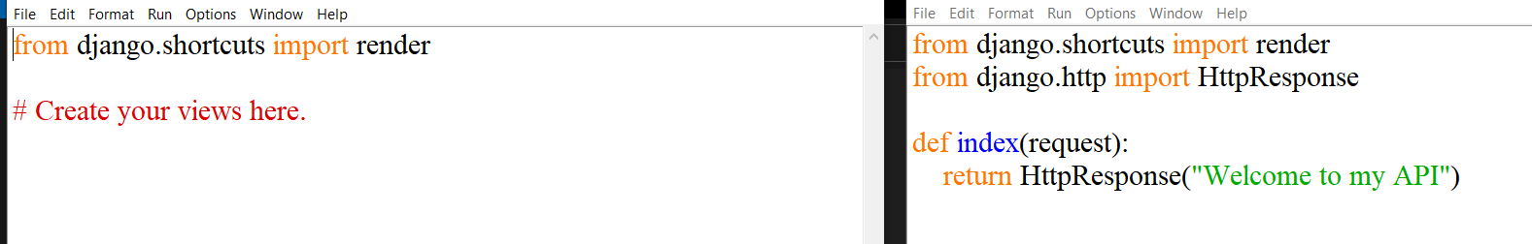
Step 3: views.py
Open the app folder views.py and we need to : to add
Step 3: views.py
Open the app folder views.py and we and 1.Http
2.create function called index
BEFORE
AFTER

Slide 19
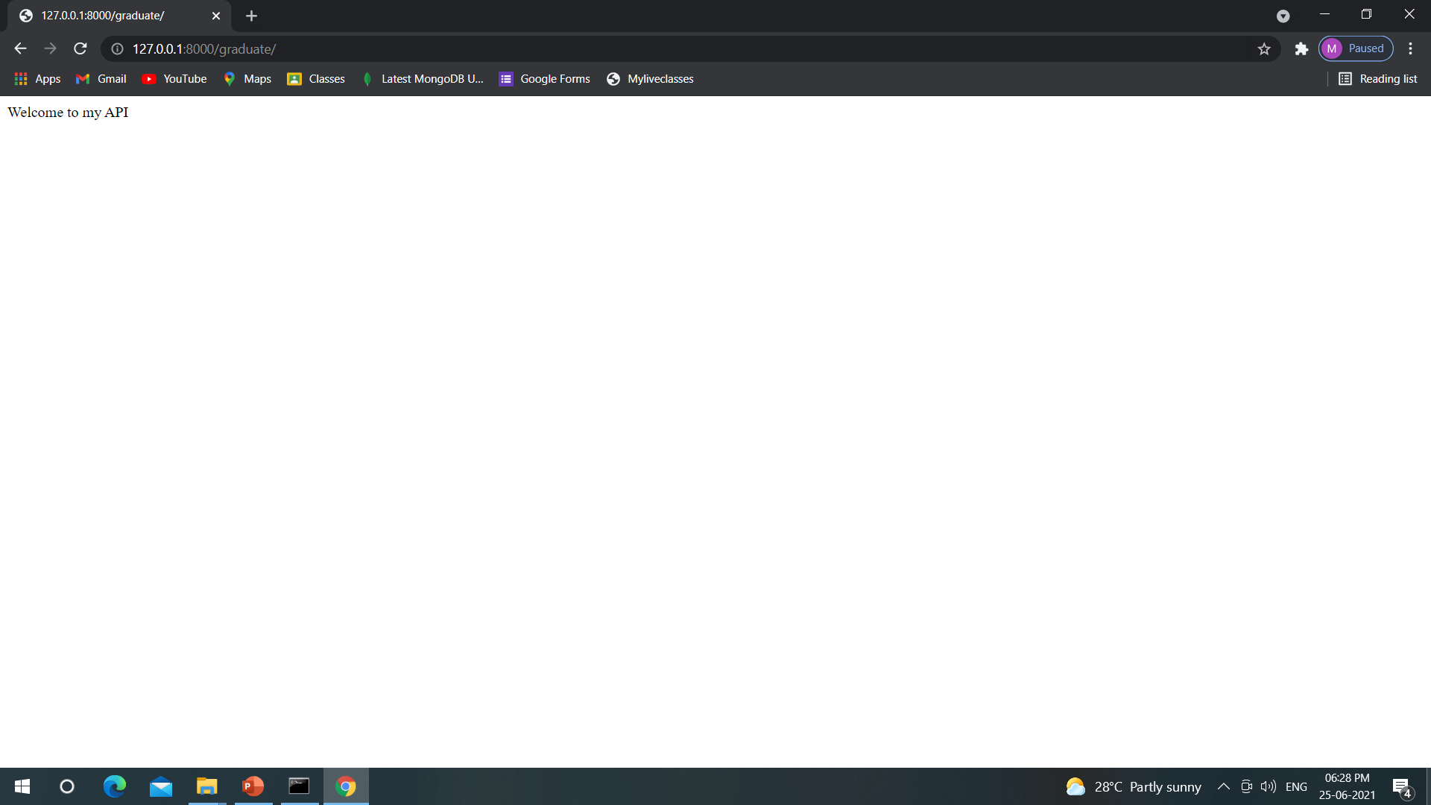
Now go to browser and refresh the page you will get this sceen

